Slide 1
Problem Solving

Slide 2
Problem-01: Be Positive
(Problem Source: https://codeforces.com/problemset/problem/2149/A )
Given an array a of n elements, where each element is equal to −1, 0, or 1.
In one operation,
you can choose an index i and increase a_{i} by 1 (that is, assign a_{i}:=a_{i}+1). Operations can be performed any number of times, choosing any indices.
The goal is to make the product of all elements in the array strictly positive with the minimum number of operations, that is, a₁⋅a₂⋅a₃⋅…⋅a_{n}>0.
Find the minimum number of operations.
It is guaranteed that this is always possible.

Slide 3
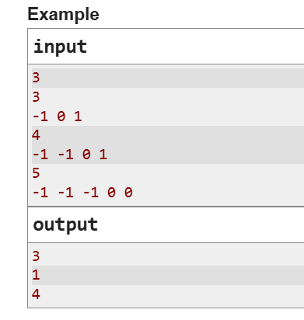
Input
Each test contains multiple test cases.
The first line contains one integer t (1≤t≤10⁴) — the number of test cases.
The description of the test cases follows:
The first line of each test case contains one integer n (1≤n≤8) — the length of the array a.
The second line contains n integers a₁,a₂,…,a_{n} , where −1≤a_{i}≤1 — the elements of the array a.
Output
For each test case, output one integer — the minimum number of operations required to make the product of the elements in the array strictly positive.

Slide 4
The Solution

Slide 5
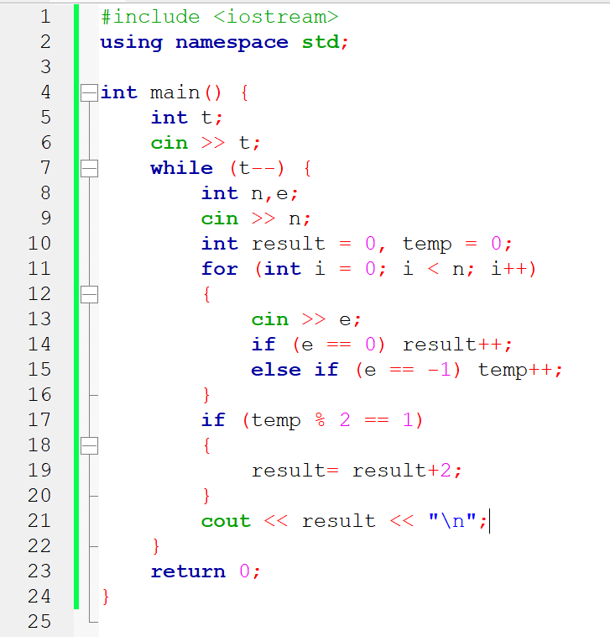

Slide 6
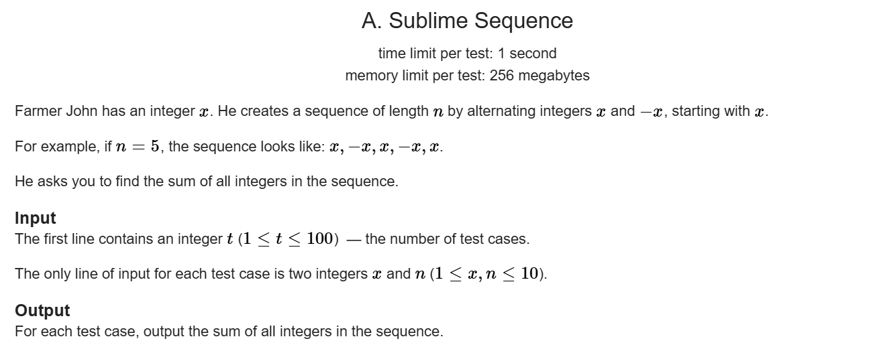
Problem-02: Sublime Sequence
(Problem Source: https://codeforces.com/problemset/problem/2149/A )
Farmer John has an integer x.
He creates a sequence of length n by alternating integers x and −x,
starting with x.
For example, if n=5, the sequence looks like: x, −x, x, −x, x.
He asks you to find the sum of all integers in the sequence.

Slide 7
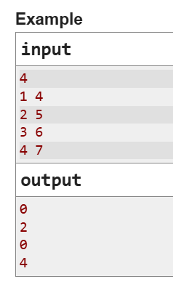
Problem-02: Sublime Sequence

Slide 8
The Solution

Slide 9
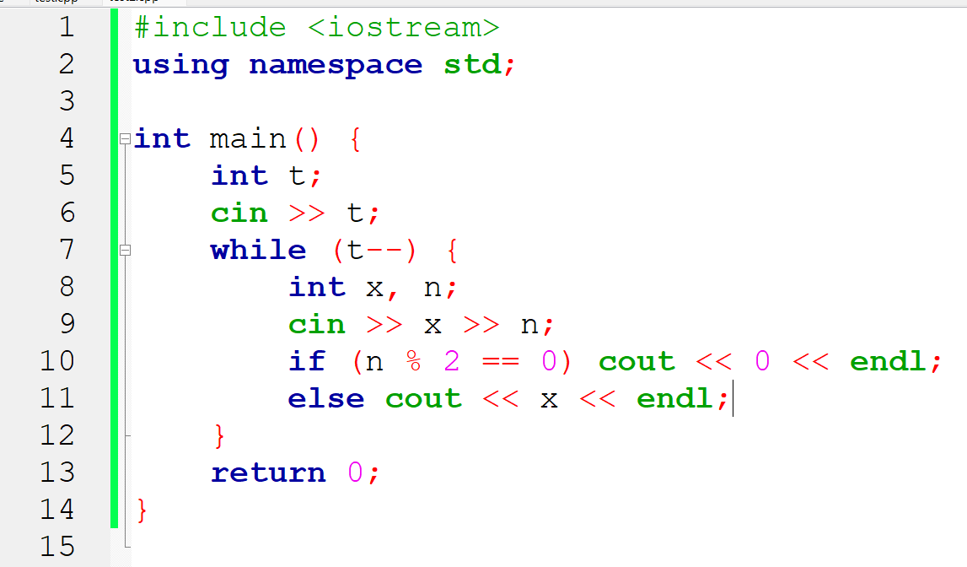

Slide 10
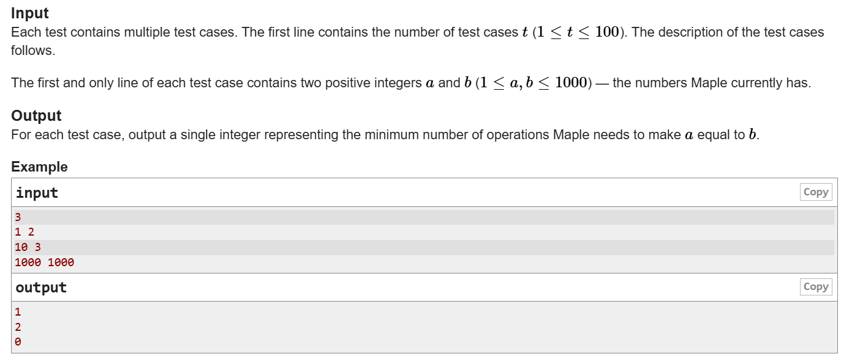
Problem-03: Maple and Multiplication
(Problem Source: https://codeforces.com/problemset/problem/2139/A )
Maple has two positive integers a and b. She may perform the following operation any number of times (possibly zero) to make a equal to b:
Choose any positive integer x, and multiply either a or b by x.
Your task is to determine the minimum number of operations required to make a equal to b. It can be proven that this is always possible.

Slide 12
The Solution

Slide 13
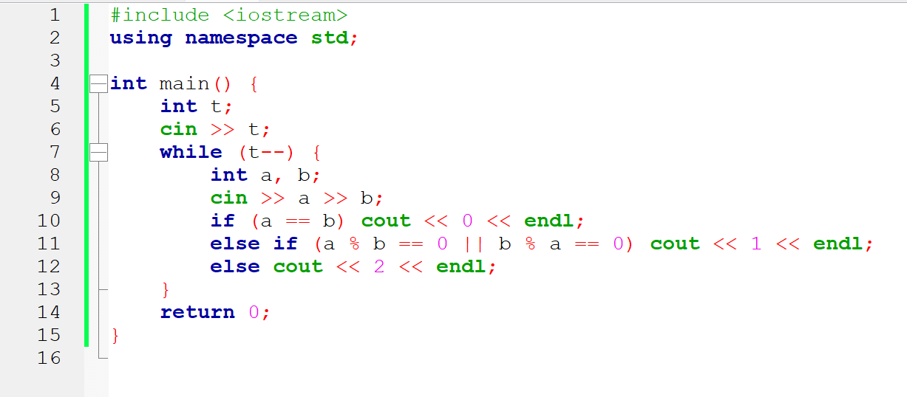

Slide 14
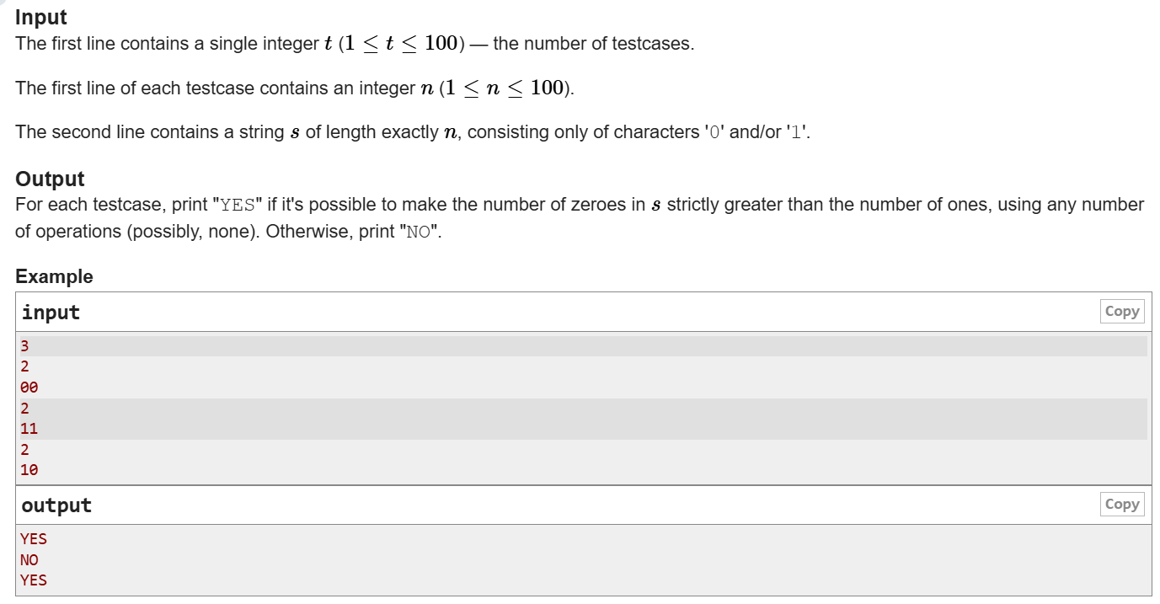
Problem-04: Binary Imbalance
(Problem Source: https://codeforces.com/problemset/problem/1902/A )
You are given a string s, consisting only of characters '0' and/or '1'.
In one operation,
you choose a position i from 1 to |s|−1, where |s| is the current length of string s.
Then you insert a character between the i-th and the (i+1)-st characters of s.
If s_{i}=s_{i}+1, you insert '1'. If s_{i}≠s_{i}+1, you insert '0'.
Is it possible to make the number of zeroes in the string strictly greater than the number of ones, using any number of operations (possibly, none)?

Slide 16
The Solution

Slide 17
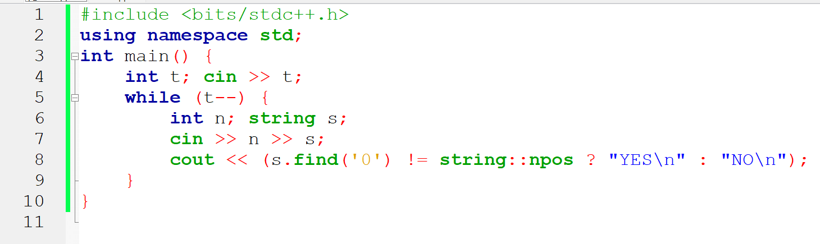
Solution-1

Slide 18
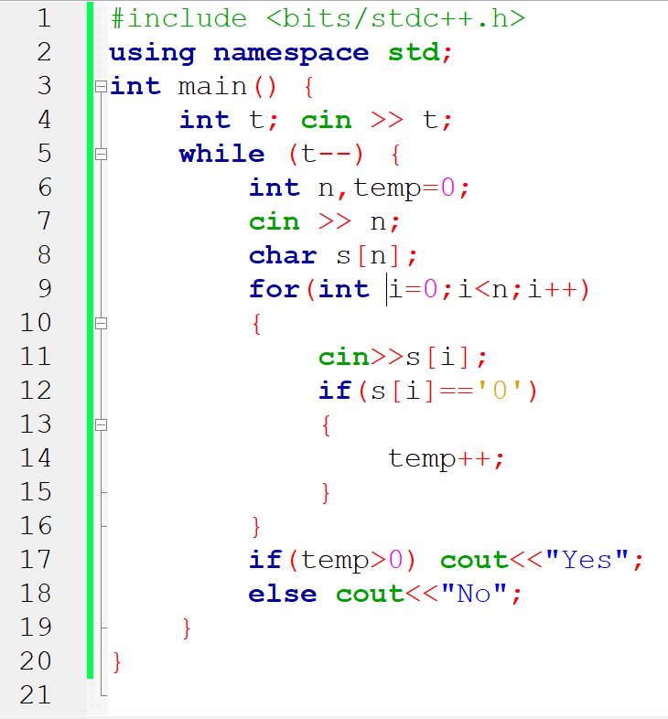
Solution-2

